Slide 1
DAT Class 5-6
Pandas & Numpy Crash Course

Slide 2
Unit 2 Schedule
GA DAT 06/24
Class 1: Pandas Fundamentals: Selection, Querying, Grouping
Class 2: Data Cleaning, Additional Operations
Class 3: Data Visualization
Class 4: Statistical Inference
Class 5: Class presentations, Statistical Inference, continued.

Slide 3
Numpy & Pandas: An Introduction
Overview
Give students a brief but coherent overview of Numpy & Pandas, plus the role they serve in the python ecosystem
Important Note
Be prepared to handle issues with installation here.
Learning Objectives
In this lesson, students will:
Get their Jupyter notebook up and running
Introduce students to IPython computing environment
Introduce students to numpy arrays & pandas dataframes
Duration
45 min - 1 hour

Slide 4
Suggested Agenda
Time | Activity | Purpose
0:00 - 0:15 | Anaconda Download + Installation | Getting everyone’s install correct, introduction to Jupyter notebook
0:16 - 0:30 | Numpy Introduction | Discuss students the important details of what makes numpy unique, its role in data science ecosystem
0:31 - 0:45 | Pandas Introduction | What it does, how it interacts with numpy, what dataframes are.
0:46 - 0:50 | Summary | Finish this portion of the lesson by having students

Slide 5
Materials and Preparation
Time spent on this lesson might be highly variable depending on how difficult a time people have with getting their operating environment up and running.
Besides getting everyone’s Jupyter Notebook up and running, focus on making sure everyone has a broad conception about what makes numpy & pandas unique, and how they interact with one another
Wrap this lesson up by using pd.read_csv() to load in a dataframe

Slide 6
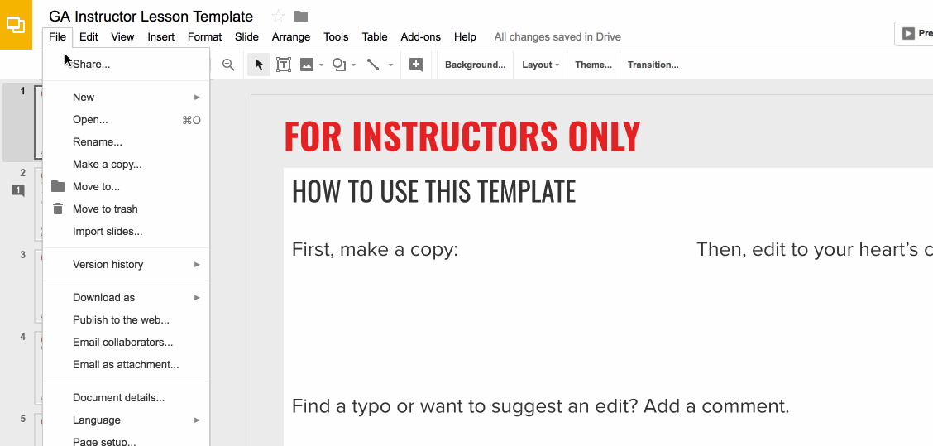
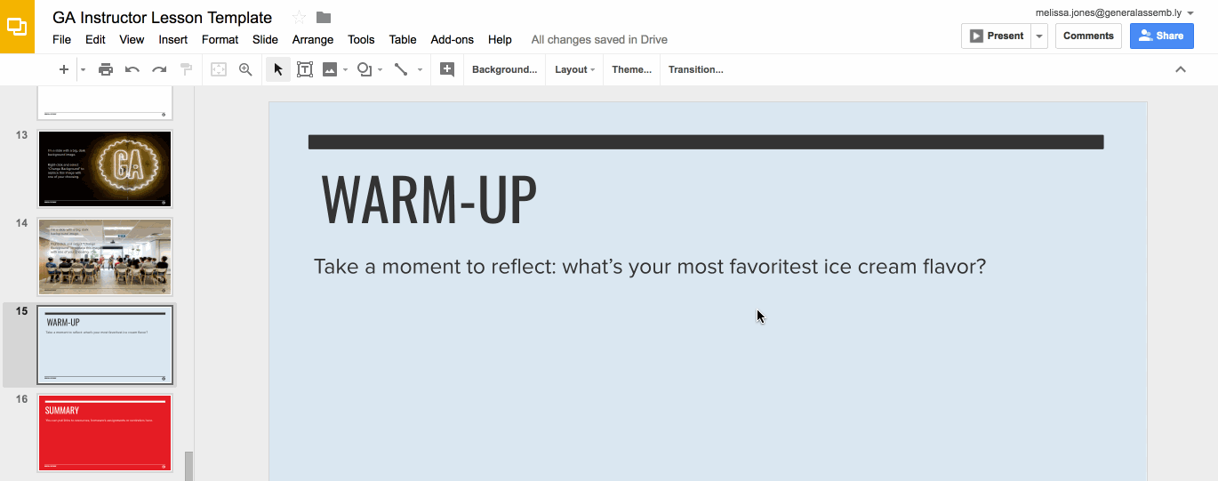
Preparation (Continued)
Ready to customize this lesson?
First things first, make a copy of this presentation. You’ll then be able to edit to your 💗’s content.
Find a typo or want to suggest an edit?
Add a comment. Our Product Advisory Board will review and incorporate your suggestions.

Slide 7

Preparation (Continued)
Remember to press Command F and do a search for instances of brackets in the deck. All instances of brackets denote places where instructors must fill in information/customize prior to presenting in class.

Slide 8
Differentiation and Extensions
This is a suggestion for a way in which instructors might change up this lesson to meet the needs of more advanced or less advanced students.
This is another suggestion.
This is another suggestion.
Be sure to link to any supplemental/optional materials on this slide.

Slide 9
Numpy & Pandas: An Introduction
Python For Data
Notes:
X MINUTES
TALKING POINTS
This is a suggested talking point.
This is another.
TEACHING TIPS
This is a suggestion for the instructor on something to do before, during or after presenting this slide.
This is another suggestion.

Slide 10
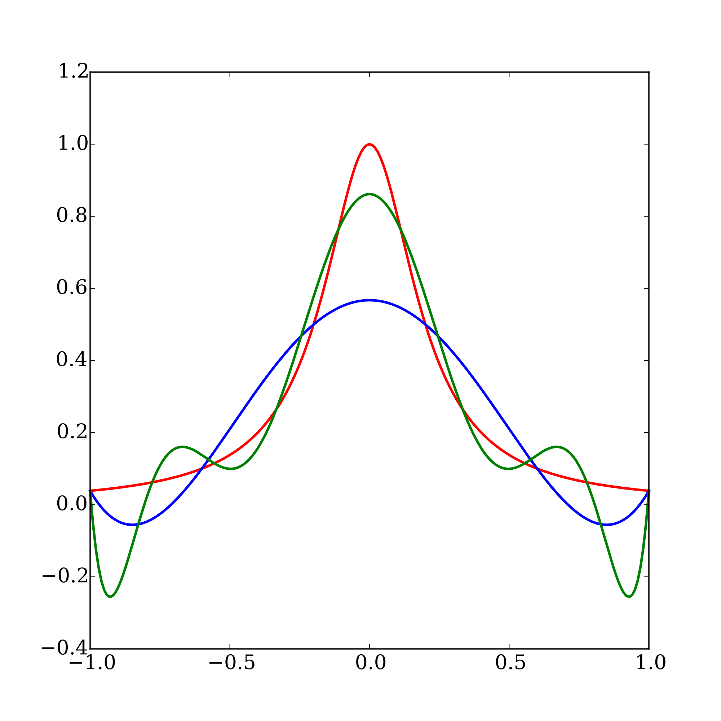
Python and Data: How They Work Together
Core Python language is not good for data analysis
Wasn’t built for it originally
Modern data analysis requires data structures that aren’t handled by native Python
But Python is everyone’s favorite language…..
Scipy ecosystem was built to make data-intensive computing feasible using Python
Notes:
3-5 MINUTES
TALKING POINTS
Emphasize that it’s not python itself that’s good for data analysis, but specific libraries built on top of it
Good idea to go to scipy.org to give students a better introduction to the ecosystem

Slide 11
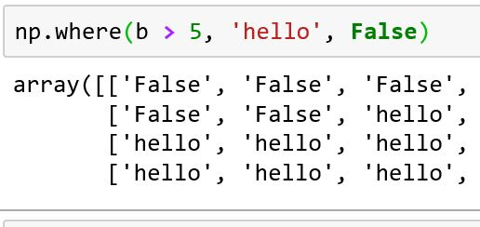
Numpy: Where It All Starts
Numpy is the most foundational of the libraries in the Scipy ecosystem
Allows you to perform computations on large amounts of data at one time
Fundamental data structure is the 2D-array
Notes:
3-5 MINUTES
TALKING POINTS
Go to Jupyter notebook after this slide to import numpy and type in a few commands to demonstrate what it does

Slide 12
Numpy: Where It All Starts
Built from the ground up for fast performance
Is only Python by appearance: compiles to C
Library is very well developed, has 500+ different methods built into it
Is the base of other data libraries built on top of it
Notes:
3-5 MINUTES
TALKING POINTS
Go to Jupyter notebook after this slide to import numpy and type in a few commands to demonstrate what it does

Slide 13
Numpy: Where It All Starts
Arrays are built around the notion of axes:
Axis 1: operates across rows
Axis 0: operates across columns
Frequent argument that can be specified in different methods
Default is usually 0
Notes:
3-5 MINUTES
TALKING POINTS
Go to Jupyter notebook after this slide to import numpy and type in a few commands to demonstrate what it does

Slide 14
Pandas
Python For Data
Notes:
X MINUTES
TALKING POINTS
This is a suggested talking point.
This is another.
TEACHING TIPS
This is a suggestion for the instructor on something to do before, during or after presenting this slide.
This is another suggestion.

Slide 15
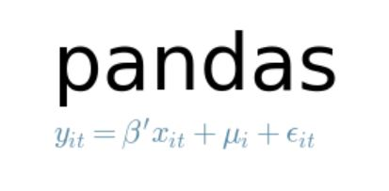
Pandas: An Introduction
Primary tool for dealing with outside data
Uses a data structure called a dataframe to do its work.
Works like a massive Excel spreadsheet that you can dynamically program
Notes:
3-5 MINUTES
TALKING POINTS
After this slide, go back to notebook and build a dataframe out of a numpy array, and then use pd.read_csv()

Slide 16
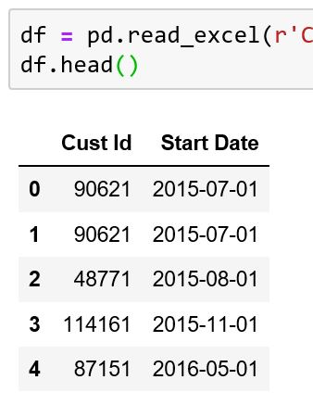
Pandas: Connecting to Data
Pandas connects to following:
CSV
Excel
SQL
JSON
STATA
SAS
HTML
others
All use the same syntax pd.read_data_type_here()
Notes:
3-5 MINUTES
TALKING POINTS
After this slide, go back to notebook and build a dataframe out of a numpy array, and then use pd.read_csv()

Slide 17
Pandas: Connecting to Data
Have the following options when reading in data:
What columns to include
What rows to include or exclude
Specific data types of different columns
Specify columns that represent time
How to infer time
Notes:
3-5 MINUTES
TALKING POINTS
After this slide, go back to notebook and build a dataframe out of a numpy array, and then use pd.read_csv()

Slide 18
Selecting & Querying Data in Pandas
Python For Data
Notes:
X MINUTES
TALKING POINTS
This is a suggested talking point.
This is another.
TEACHING TIPS
This is a suggestion for the instructor on something to do before, during or after presenting this slide.
This is another suggestion.

Slide 19
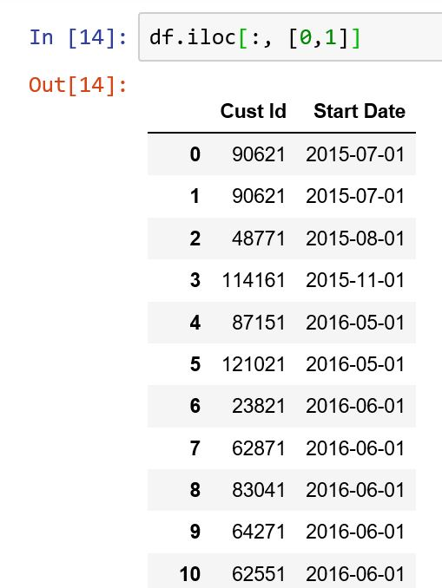
Pandas: Selecting Data
Can select data via rows and columns
Can grab values both using labels and index positions
Usually happens with two primary commands:
.loc: grab data by its labels
.iloc: grab data by its index position
Notes:
3-5 MINUTES
TALKING POINTS
Go back into Jupyter notebook, and demonstrate how these commands work:
Try going over the following:
Grabbing one and multiple columns using labels
Column and row notation
Using both the .loc and .iloc commands, and their various manifestations.

Slide 20
Activity #1
Complete Section 1 Of Your Class Lab
Take 10 minutes to practice selecting and indexing your data
Notes:
X MINUTES
TALKING POINTS
This is a suggested talking point.
This is another.
TEACHING TIPS
This is a suggestion for the instructor on something to do before, during or after presenting this slide.
This is another suggestion.

Slide 21
Pandas: Selecting Data w/ Conditions
Can use Pandas to query data similar to what you’d use in SQL
Allows you to dynamically select different columns with complex conditions
Uses a slightly different syntax than traditional Python selection operators
Notes:
3-5 MINUTES
TALKING POINTS
After this slide, go back to Jupyter notebook and demonstrate different querying techniques:
Selecting based on one condition
Selecting with AND/OR keywords
How to select individual columns with queries

Slide 22
Activity #2
Complete Exercise #2 In Your Lab
Take 10 minutes to practice querying your data. Use the answers provided to confirm that you did the operation correctly.
Notes:
X MINUTES
TALKING POINTS
This is probably a good time to go to lunch.

Slide 23
Creating and Manipulating Data in Pandas
Python For Data
Notes:
X MINUTES
TALKING POINTS
This is a suggested talking point.
This is another.
TEACHING TIPS
This is a suggestion for the instructor on something to do before, during or after presenting this slide.
This is another suggestion.

Slide 24
Pandas: Creating Data
Variables are manipulated using vectorized code
5 primary methods
np.where()
np.select()
df.map()
pd.cut()
df.apply()
Notes:
3-5 MINUTES
TALKING POINTS
After this slide, go back to Jupyter notebook and demonstrate different querying techniques:
Selecting based on one condition
Selecting with AND/OR keywords
How to select individual columns with queries

Slide 25
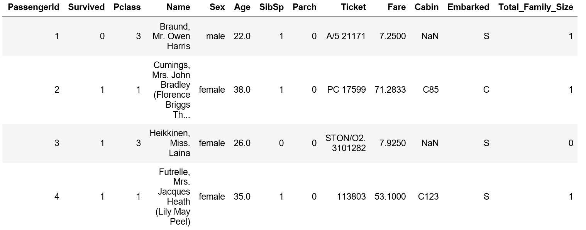
Activity #3
Create a new column called ‘family_size’ that’s the combination of the SibSP and Parch columns. This column indicates the total amount of company everyone had on board with them.
Notes:
X MINUTES
TALKING POINTS
This is probably a good time to go to lunch.

Slide 26
Pandas: Creating Data
np.where():
Simple way to create if/else statement to create new variables
np.select():
Advanced version of np.where() - can create multiple conditions
Notes:
3-5 MINUTES
TALKING POINTS
After this slide, go back to Jupyter notebook and demonstrate different querying techniques:
Selecting based on one condition
Selecting with AND/OR keywords
How to select individual columns with queries

Slide 27
Pandas: Creating Data
df.map():
Allows you to switch values from one to another, without using logic
pd.cut():
Used for converting a numeric column to a categorical one, using bins
df.apply():
Allows you to write a custom function
Notes:
3-5 MINUTES
TALKING POINTS
After this slide, go back to Jupyter notebook and demonstrate different querying techniques:
Selecting based on one condition
Selecting with AND/OR keywords
How to select individual columns with queries

Slide 28
Activity #4
Complete section 4 of your lab. Finish this section with a partner if you’d like.
Notes:
X MINUTES
TALKING POINTS
This is probably a good time to go to lunch.

Slide 29
Popular Pandas Methods
Python For Data
Notes:
X MINUTES
TALKING POINTS
This is a suggested talking point.
This is another.
TEACHING TIPS
This is a suggestion for the instructor on something to do before, during or after presenting this slide.
This is another suggestion.

Slide 30
Pandas: Popular Methods
Pandas has a lot of built in methods to handle your data
Mostly done with the intention of querying your data in different ways
Also very flexible for creating your own -- we’ll discuss later
Methods can also be chained together
Notes:
3-5 MINUTES
TALKING POINTS
After this slide, go back to Jupyter notebook and demonstrate different querying techniques:
Selecting based on one condition
Selecting with AND/OR keywords
How to select individual columns with queries

Slide 31
Pandas: groupby()
One of the more common techniques
Allows your data to work in similar ways to a pivot table
Also done in a similar manner as SQL’s GROUP BY
Notes:
3-5 MINUTES
TALKING POINTS
After this slide, go back to Jupyter notebook and demonstrate different querying techniques:
Selecting based on one condition
Selecting with AND/OR keywords
How to select individual columns with queries

Slide 32
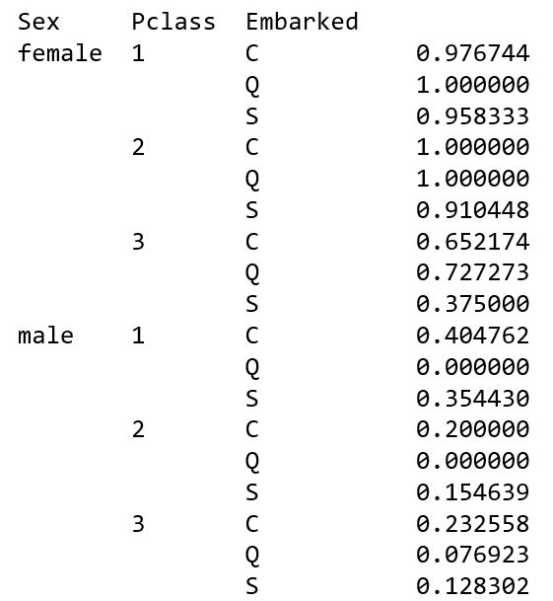

Slide 33
Visualizations with Pandas and Matplotlib
Python For Data
Notes:
X MINUTES
TALKING POINTS
This is a suggested talking point.
This is another.
TEACHING TIPS
This is a suggestion for the instructor on something to do before, during or after presenting this slide.
This is another suggestion.

Slide 34
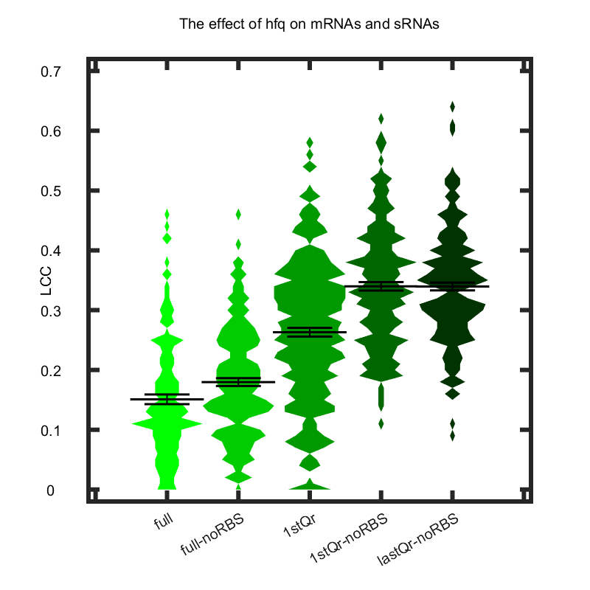
Visualization
Matplotlib is primary tool for creating libraries in Python
Pandas allows you to access the matplotlib API without using it directly
Notes:
3-5 MINUTES
TALKING POINTS
After this slide, go back to Jupyter notebook and demonstrate different querying techniques:
Selecting based on one condition
Selecting with AND/OR keywords
How to select individual columns with queries

Slide 35
Visualization
Charts you can make using the plot() function:
Bar
Barh
Line
Histogram
Boxplot
Kernel density plot
Area
Scatter
Hexbin
Notes:
3-5 MINUTES
TALKING POINTS
After this slide, go back to Jupyter notebook and demonstrate different querying techniques:
Selecting based on one condition
Selecting with AND/OR keywords
How to select individual columns with queries

Slide 36
Seaborn
Popular data viz library built on top of matplotlib
Better at creating useful charts right out of the box
Usually the best way to do exploratory data analysis
Notes:
3-5 MINUTES
TALKING POINTS
After this slide, go back to Jupyter notebook and demonstrate different querying techniques:
Selecting based on one condition
Selecting with AND/OR keywords
How to select individual columns with queries

Slide 37
Activity #7
Take 20-25 minutes to do your own independent exercise on either this dataset, or another one of your choosing.
Notes:
X MINUTES
TALKING POINTS
This is probably a good time to go to lunch.

Slide 38
Optimizing Performance
Python For Data
Notes:
X MINUTES
TALKING POINTS
This is a suggested talking point.
This is another.
TEACHING TIPS
This is a suggestion for the instructor on something to do before, during or after presenting this slide.
This is another suggestion.

Slide 39
Pandas: Optimizing Performance
Big differentiator between Excel and other tools
Can usually handle millions of rows in a dataset on your laptop
Pandas does not optimize memory out of the box
Notes:
3-5 MINUTES
TALKING POINTS
After this slide, go back to Jupyter notebook and demonstrate different querying techniques:
Selecting based on one condition
Selecting with AND/OR keywords
How to select individual columns with queries

Slide 40
Pandas: Optimizing Performance
Basic data types in Pandas:
Integer: 8, 16, 32, 64 bit
Float: 16, 32, 64 bit
Datetime: np.datetime64
Boolean: True/False
Text: object/category
Notes:
3-5 MINUTES
TALKING POINTS
After this slide, go back to Jupyter notebook and demonstrate different querying techniques:
Selecting based on one condition
Selecting with AND/OR keywords
How to select individual columns with queries

Slide 41
Pandas: Optimizing Performance
 | Numeric Range | Signed Range | Unsigned Range
8 bit | 2⁸ | -128 to 127 | 0 to 255
16 bit | 2¹⁶ | -32768 to 32767 | 0 to 65535
32 bit | 2³² | -2147483648 to 2147483647 | 0 to 4294967295
64 bit | 2⁶⁴ | -9223372036854775808 to 9223372036854775807 | 0 to 18446744073709551615
Notes:
3-5 MINUTES
TALKING POINTS
After this slide, go back to Jupyter notebook and demonstrate different querying techniques:
Selecting based on one condition
Selecting with AND/OR keywords
How to select individual columns with queries

Slide 42
Pandas: Optimizing Performance
Objects vs. Categories:
Both used to store text
Categories are usually superior
Less memory
Lots of available methods
More natural way to process data
Custom data type within pandas
Notes:
3-5 MINUTES
TALKING POINTS
After this slide, go back to Jupyter notebook and demonstrate different querying techniques:
Selecting based on one condition
Selecting with AND/OR keywords
How to select individual columns with queries

Slide 43
Pandas: Optimizing Performance
Important methods:
astype()
dtype()
select_dtypes()
memory_usage()
to_sparse()
Notes:
3-5 MINUTES
TALKING POINTS
After this slide, go back to Jupyter notebook and demonstrate different querying techniques:
Selecting based on one condition
Selecting with AND/OR keywords
How to select individual columns with queries

Slide 44
Activity #8
Complete Exercise #8 On Your Handout
Read in a portion of grocery_sales.csv, using the skiprows argument, and then create a dictionary re-assigning each variable to its newer, optimal data type. The dataset is 1.2 million rows long.
Re-read your dataframe into pandas utilizing the dtype and parse_dates argument, and see how much smaller your dataframe’s memory is. It should be around 29 mb.
Notes:
X MINUTES
TALKING POINTS
This is probably a good time to go to lunch.

Slide 45

Pandas: Optimizing Performance
The Feather:
New file type optimized for columnar data
Borne out of project called Apache Arrow
Allows you to read data off of CPU without reading it
Takes advantage of new CPU architecture
Notes:
3-5 MINUTES
TALKING POINTS
After this slide, go back to Jupyter notebook and demonstrate different querying techniques:
Selecting based on one condition
Selecting with AND/OR keywords
How to select individual columns with queries

Slide 46
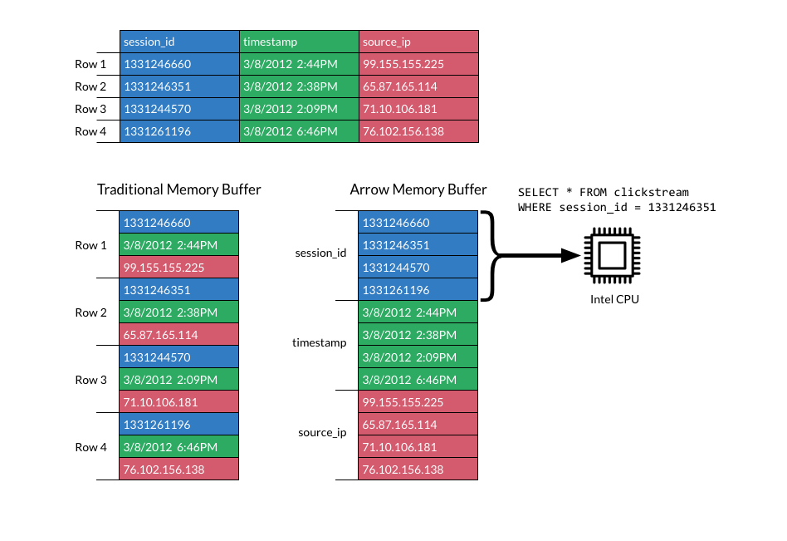
Notes:
3-5 MINUTES
TALKING POINTS
After this slide, go back to Jupyter notebook and demonstrate different querying techniques:
Selecting based on one condition
Selecting with AND/OR keywords
How to select individual columns with queries

Slide 47
Thank You!
Notes:
X MINUTES
TALKING POINTS
This is a suggested talking point.
This is another.
TEACHING TIPS
This is a suggestion for the instructor on something to do before, during or after presenting this slide.
This is another suggestion.

